Slide 1
Introduction to Apache Kafka
From Sync vs Async to Event-Driven Development

Slide 2
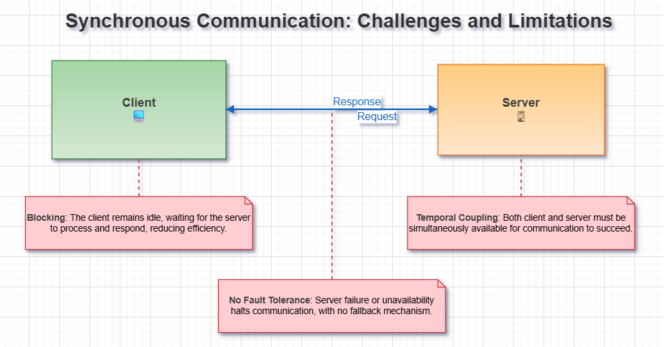
Synchronous vs Asynchronous

Slide 4
Event-Driven Development
An event represents something that happened in the system.
Events are immutable: once they occur, they cannot be changed or undone.
Instead of undoing, we can compensate with new events.

Slide 5
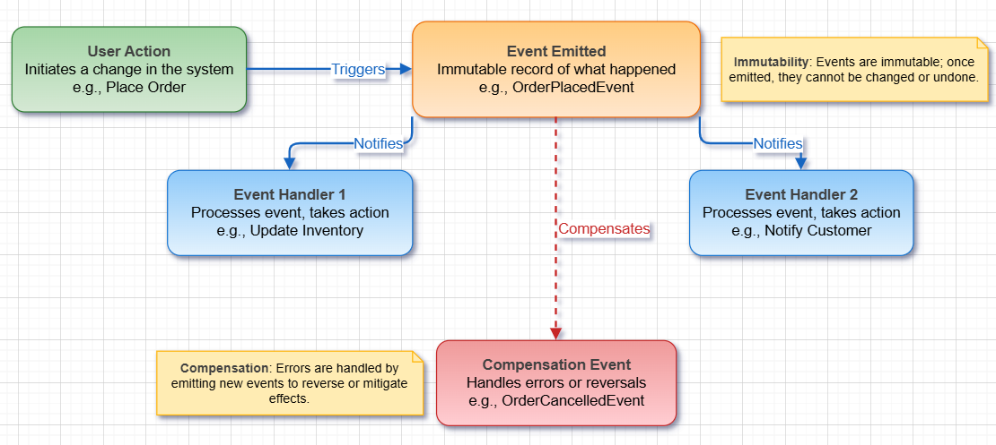

Slide 6
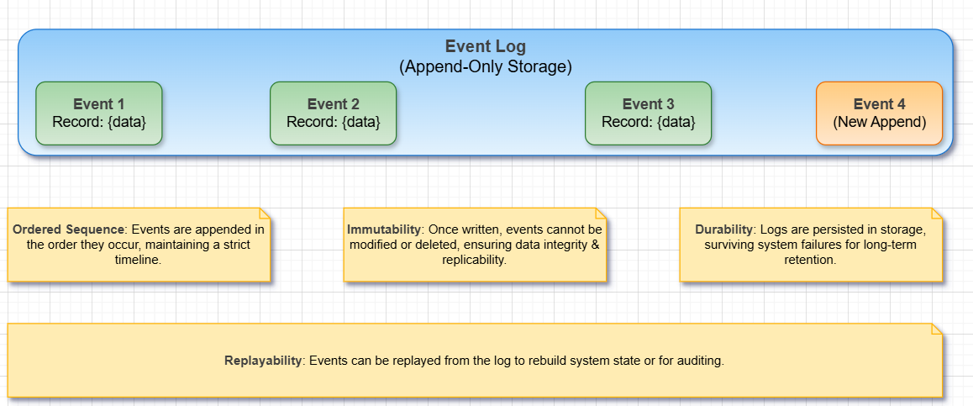
The Concept of a Log
A log is an ordered, immutable sequence of records. Events are stored in logs for durability and replayability.

Slide 7
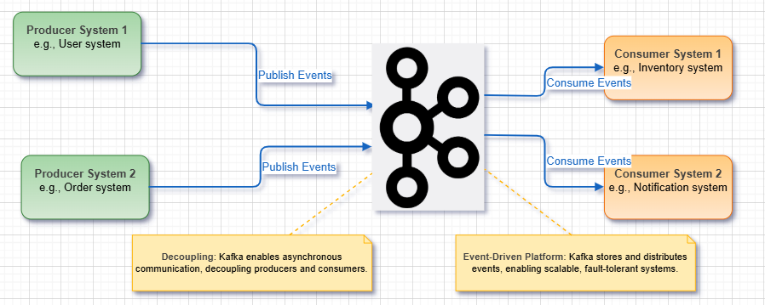
Kafka

Slide 8
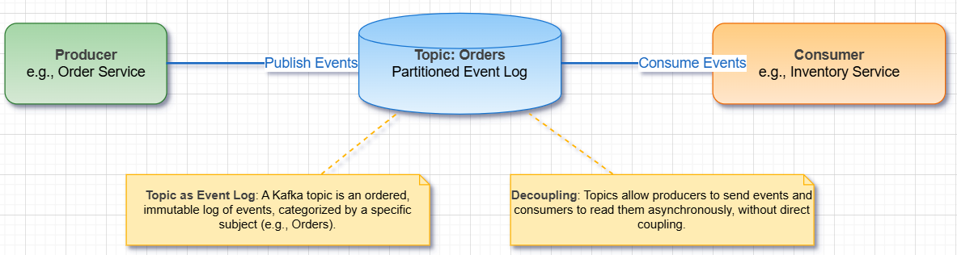
Kafka Architecture
A topic is a category/feed name to which records are stored. Internally, a topic is implemented as a log
Producers publish events to topics.
Consumers subscribe and process events.

Slide 9
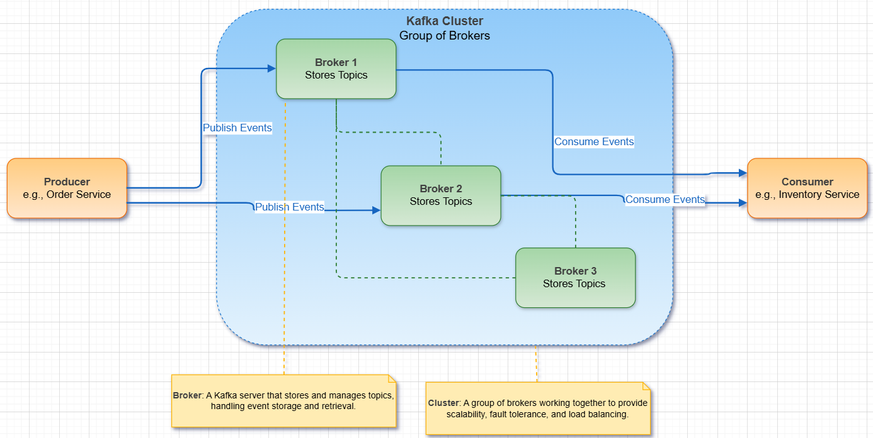
Brokers and Clusters

Slide 10
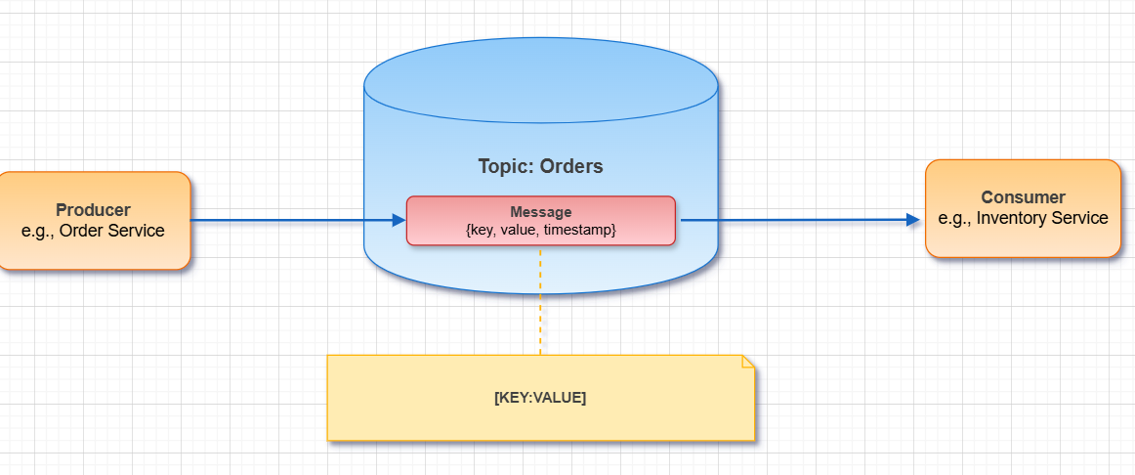
Message

Slide 11
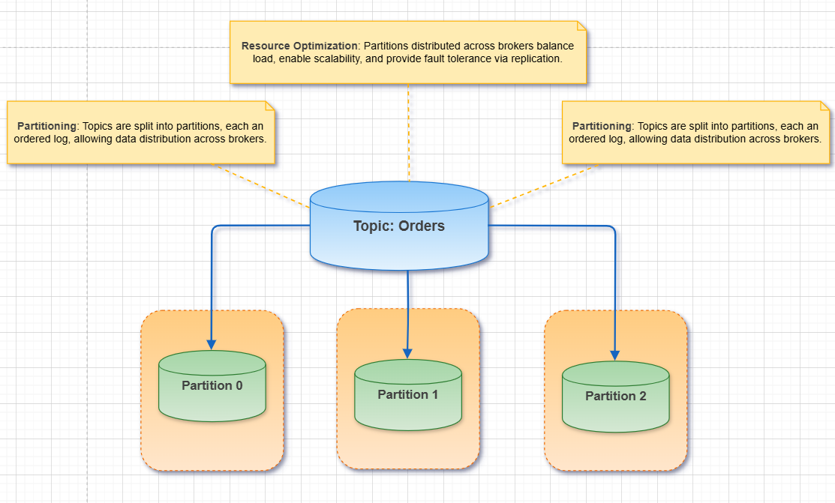
Partitions and Performance

Slide 12
Partitioning strategies
Determines which partition a message goes to:
Round Robin : Messages distributed evenly across partitions (order cannot be preserved)
Key-Based (Hashing): Kafka hashes the key to determine the partition (messages with same key go to the same partition → ordering guaranteed per key)
partition = (hash(key)mod NPartitions)
Custom : implement custom partitioning (do not until you have no choice)
Kafka by default uses Round robin for messages with null key, and Key-Based for messages with non null keys

Slide 13
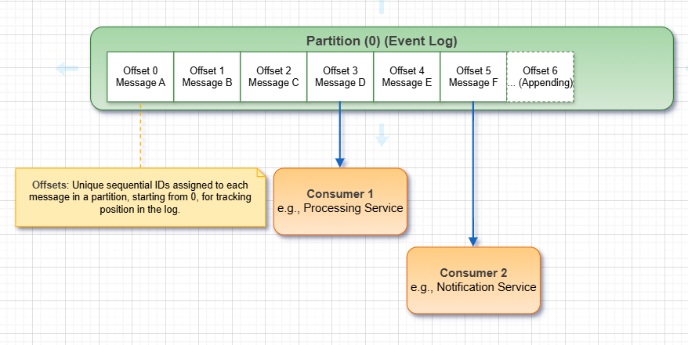
offsets

Slide 14
Offsets management
Where Offsets Are Stored:
By default, Kafka stores offsets in an internal topic called __consumer_offsets. This allows consumers to resume from their last committed position after restart.
Offset Tracking Methods:
Automatic Commit (enable.auto.commit=true)
Kafka automatically commits offsets at intervals (auto.commit.interval.ms).
Pros: Simple, no extra code.
Cons: Risk of message loss or duplicates if consumer crashes before commit.
Manual Commit (enable.auto.commit=false)
Consumer commits offsets explicitly in code using commitSync() or commitAsync().
Pros: More control → ensures at-least-once processing.
Cons: Slightly more complex to implement.

Slide 15
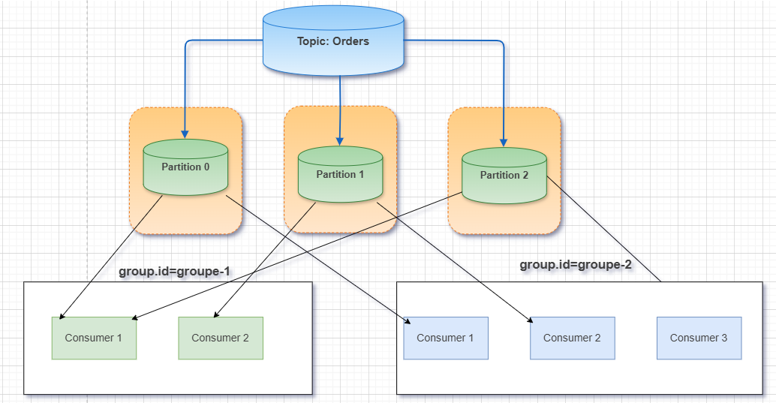
Consumer Groups and Parallelism
A consumer group allows multiple consumers to share partitions in order to distribute load and achieve parallelisme.

Slide 16
Rebalancing
Rebalancing occurs when Kafka reassigns partitions to consumers in a consumer group.
Triggers:
A new consumer joins the group
A consumer leaves or crashes
Partition count changes in the topic
Purpose:
Ensure all partitions are assigned to active consumers
Maintain parallelism and load balance

Slide 17
Serialization and Deserialization
Brokers store everything as bytes and do not manage data types nor schemas (to simplify brokers).
Serialization (Producer Side):
Converts Java objects or data into byte arrays before sending to Kafka.
[key (string), value (json)] => [bytes, bytes]
Deserialization (Consumer Side):
Converts byte arrays back into objects for the consumer to process.
Must use the same format as the producer to correctly read the data.
[bytes, bytes]=> [key (string), value (json)]

Slide 18
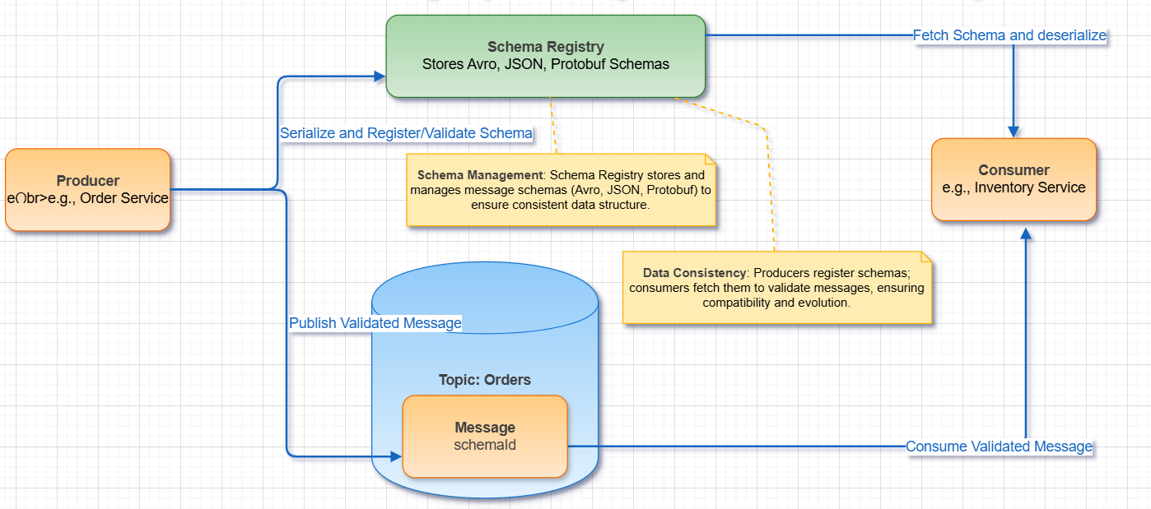
Schema Registry
Manages message schemas (Avro, JSON, Protobuf). Ensures producers and consumers agree on data structure.

Slide 19
Schema compatibility
Do not break consumers, there are three types of compatibility
Backward Compatibility
Forward Compatibility
Full compatibility (Backward and Forward)

Slide 20
Backward compatibility
Definition:
New schema (Vn) can read old data (Vn-1)
Rules / Examples:
Remove a field in Vn → Old data has extra field → New schema can still read ✅
Add a field with a default value in Vn → Old data doesn’t have it → Default value is used ✅
Takeaway:
Ensures consumers can upgrade safely without breaking existing data

Slide 21
Forward compatibility
Definition:
Old schema (Vn-1) can read new data (Vn)
Rules / Examples:
Add a field in Vn → Old schema ignores extra field → works ✅
Remove a field with default value in Vn-1 → Old schema still has default → works ✅
Takeaway:
Ensures producers can upgrade safely without breaking old consumers.

